Slide 1
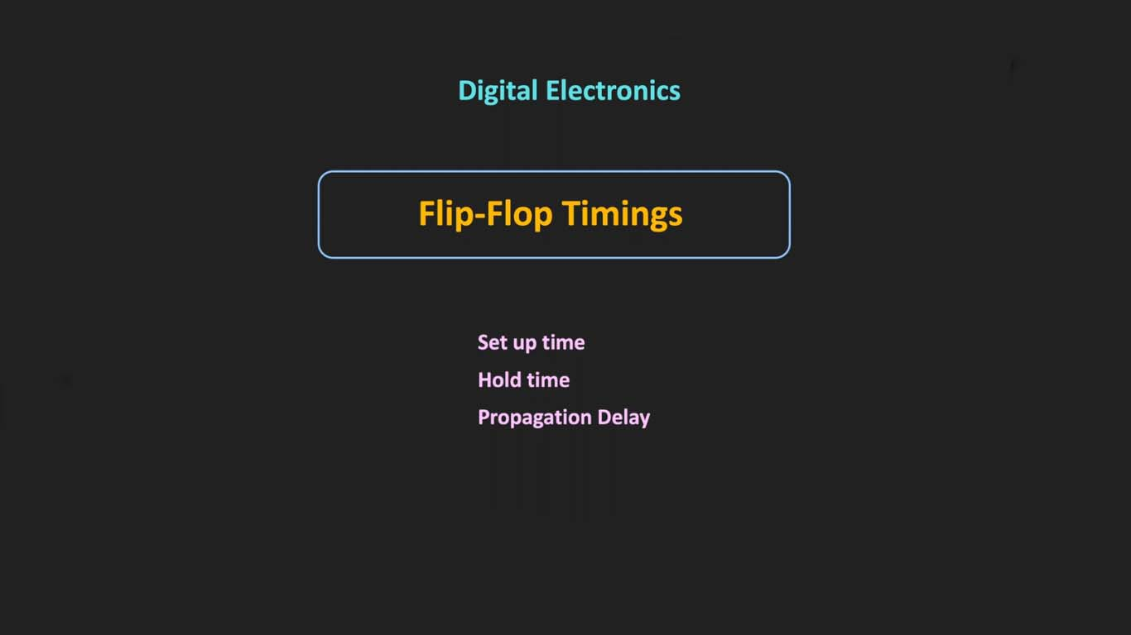

Slide 2
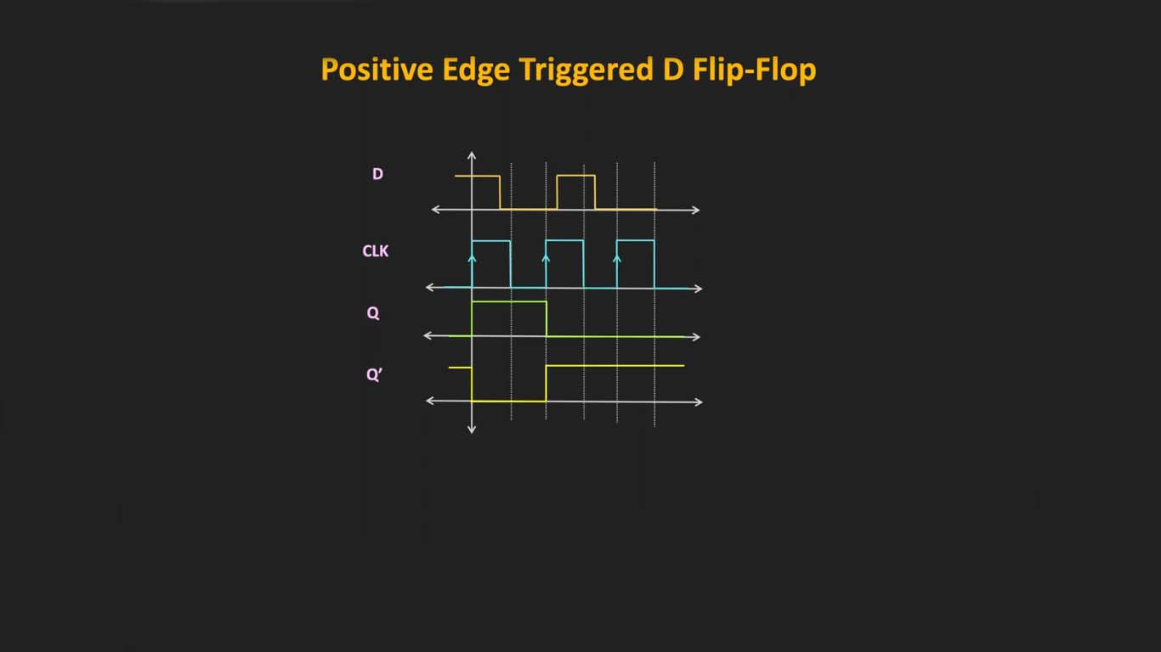

Slide 3
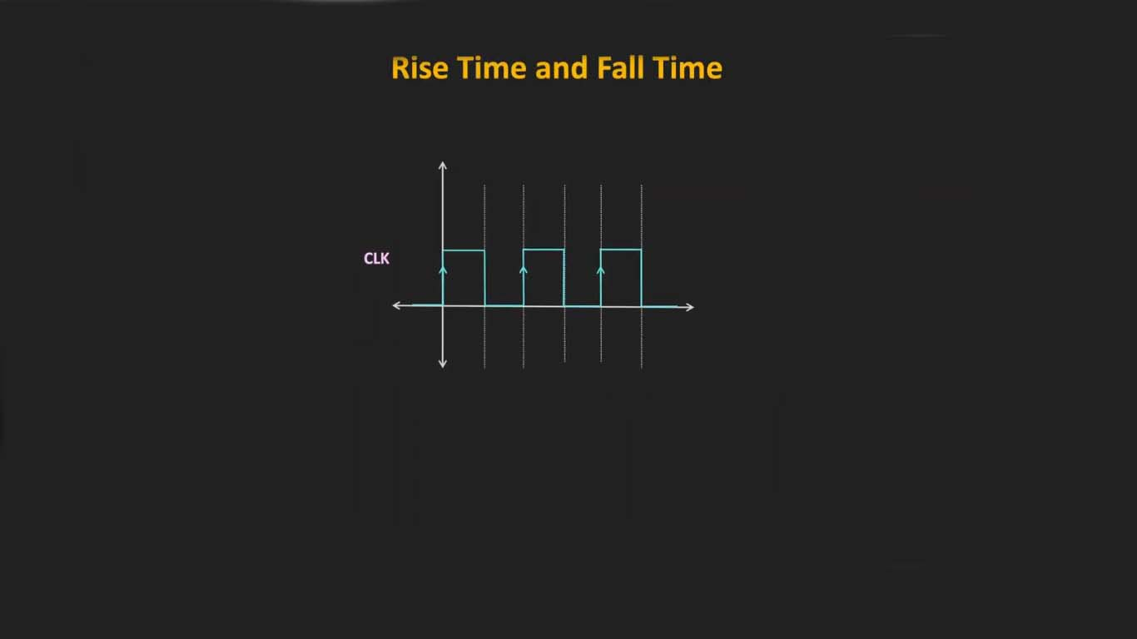

Slide 4
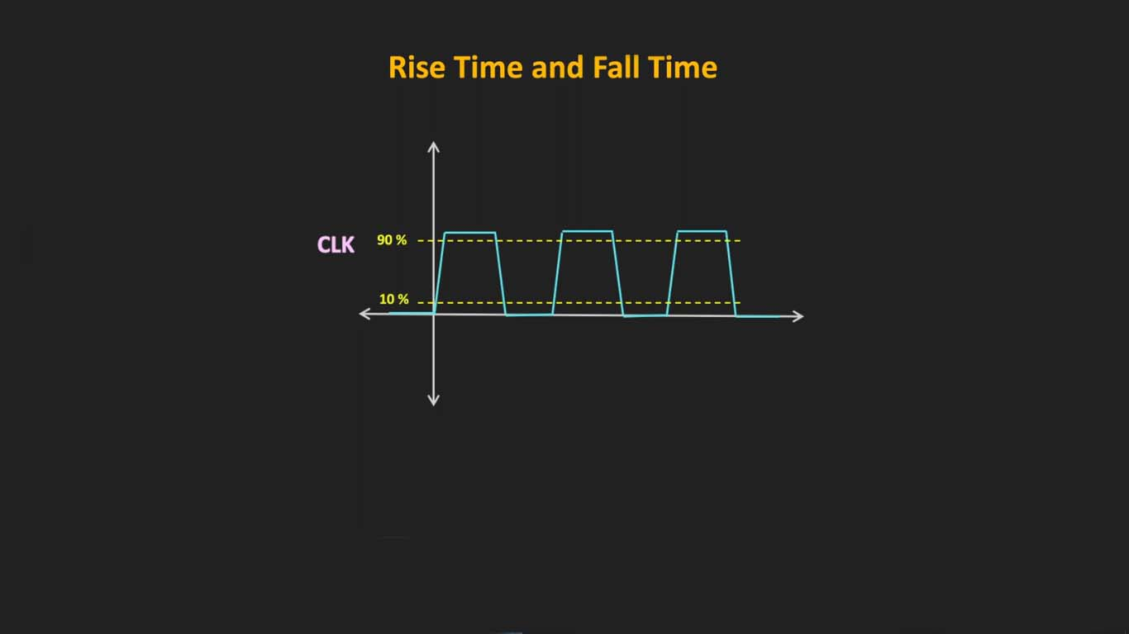

Slide 5
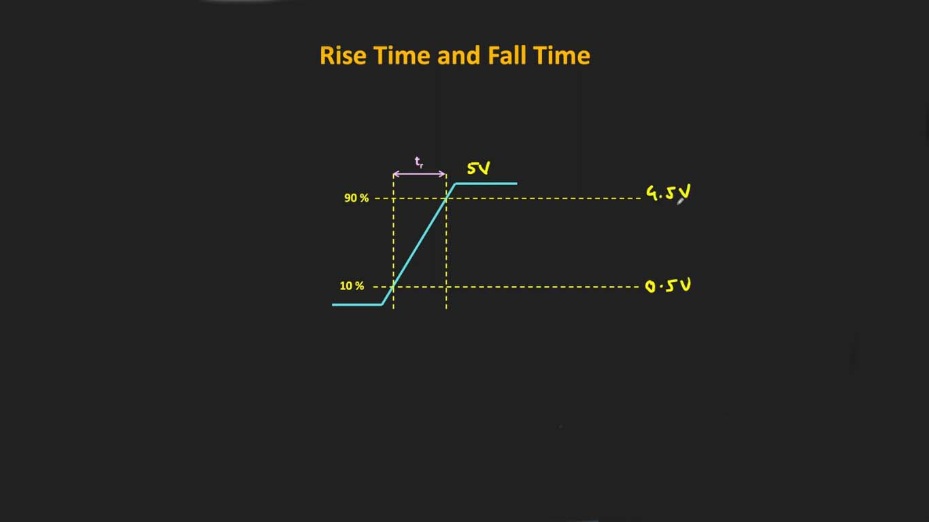

Slide 6
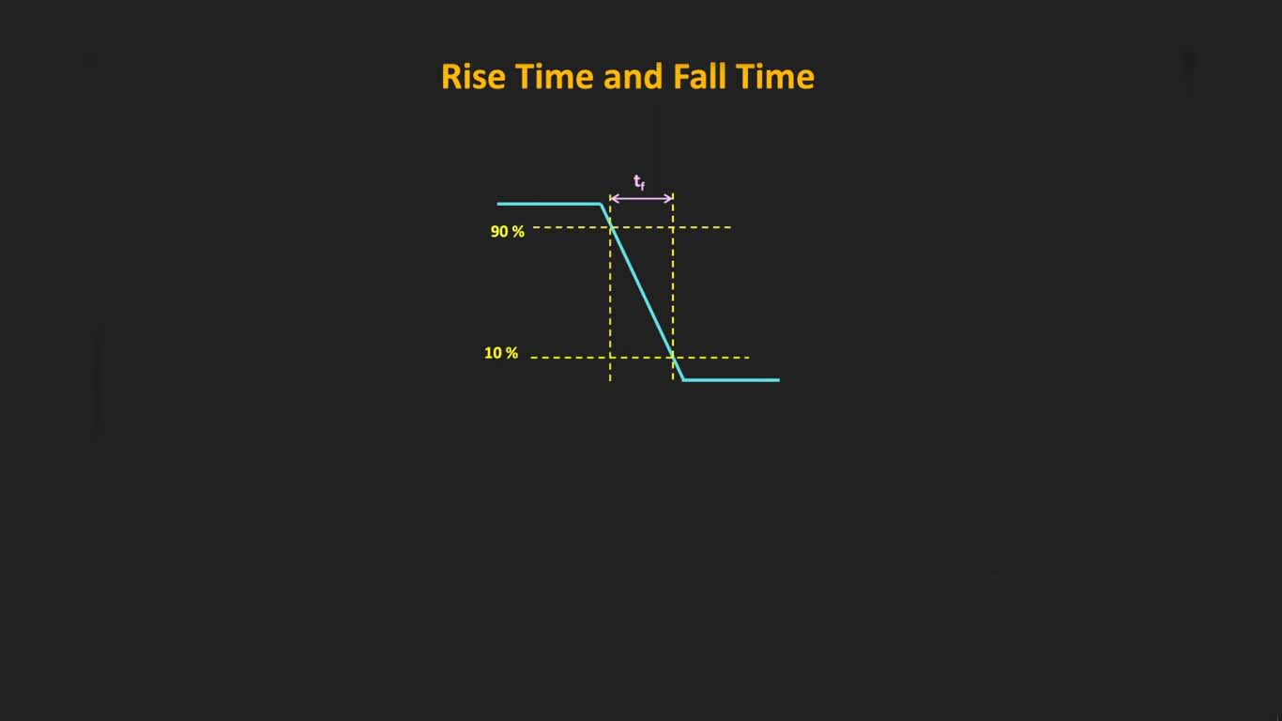

Slide 7
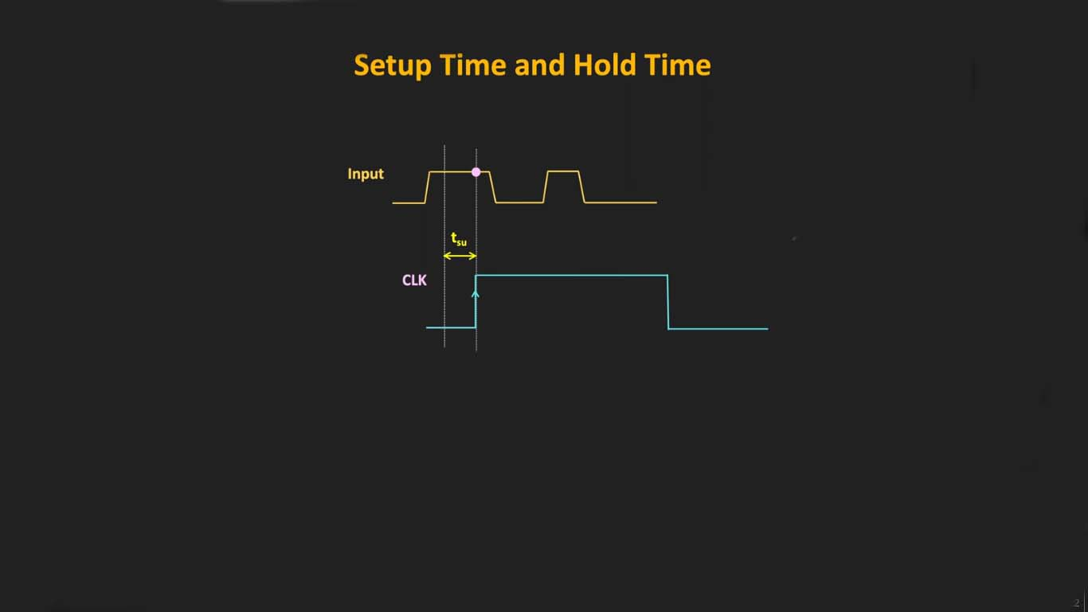
Setup time is the amount of time required for the input to a Flip-Flop to be stable before a clock edge

Slide 8
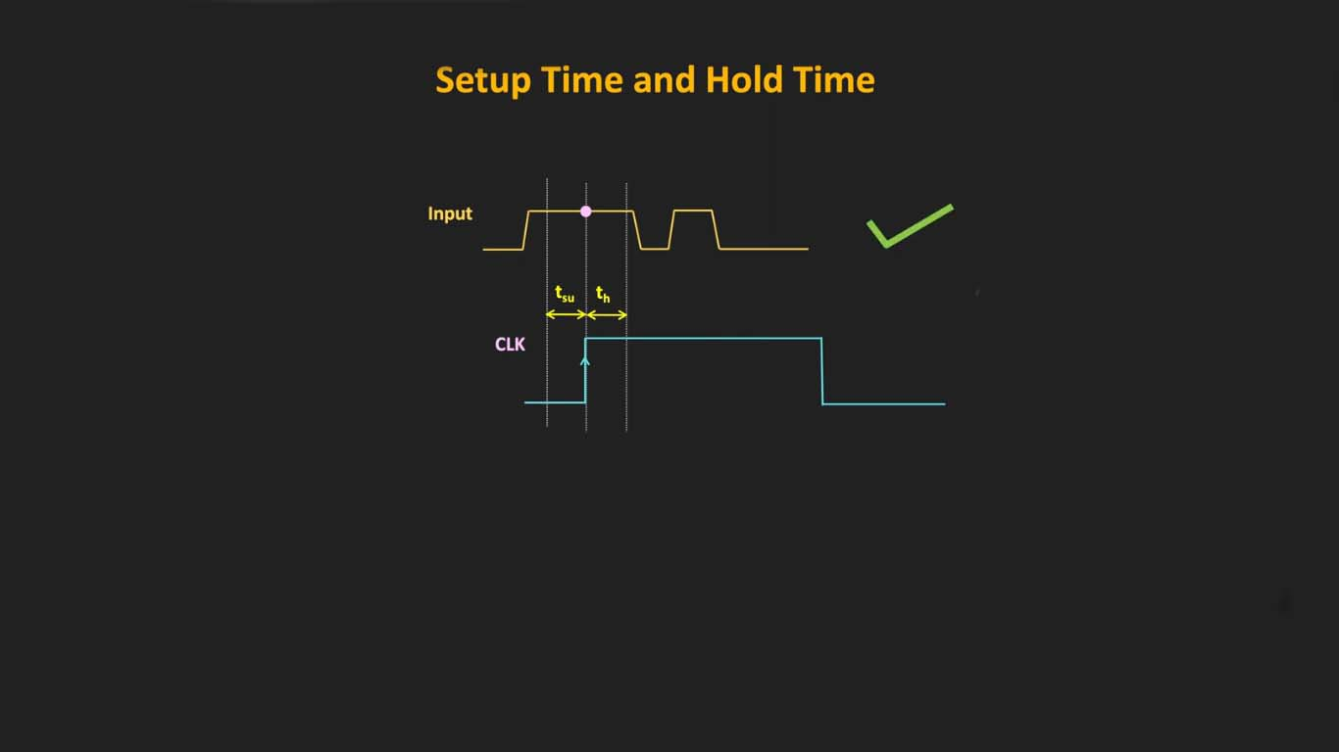
Hold time is similar to setup time, but it deals with events after a clock edge occurs. Hold time is the minimum amount of time required for the input to a Flip-Flop to be stable after a clock edge

Slide 9
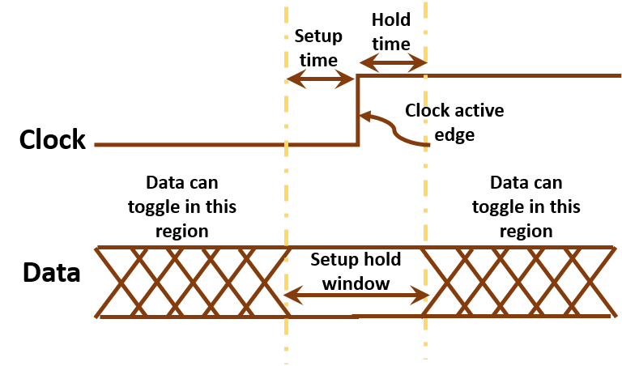

Slide 10
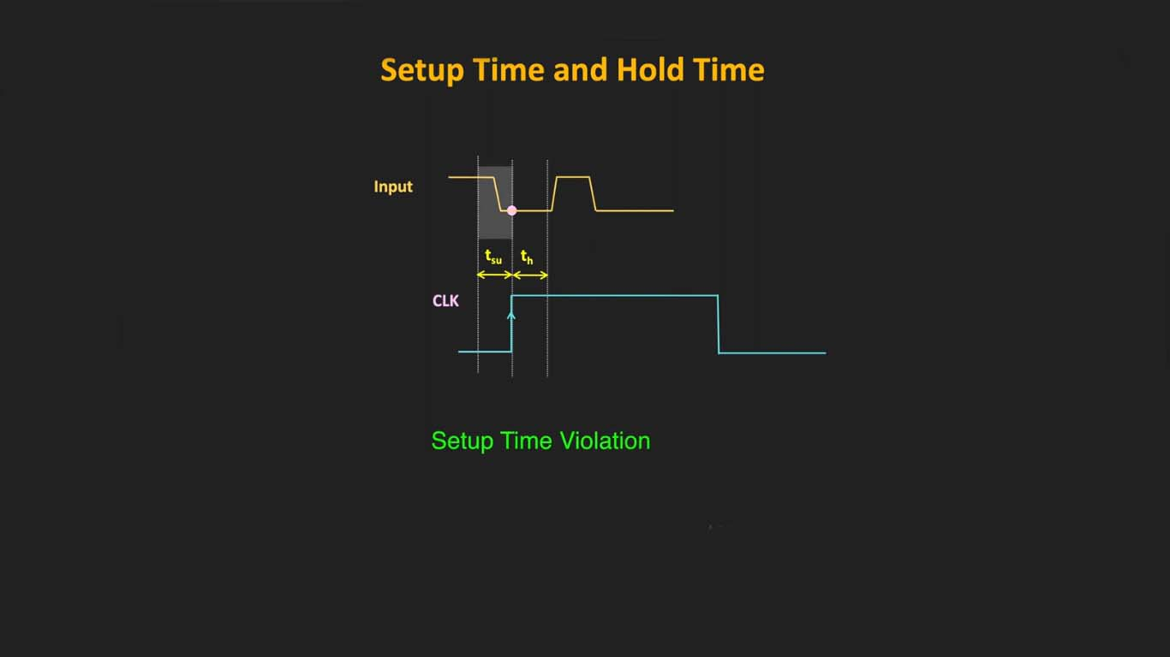
If your design has setup or hold time violations, the Flip-Flop output is not guaranteed to be stable. It could be zero, it could be one, it could be somewhere in the middle, it’s not known. This is called metastability

Slide 11
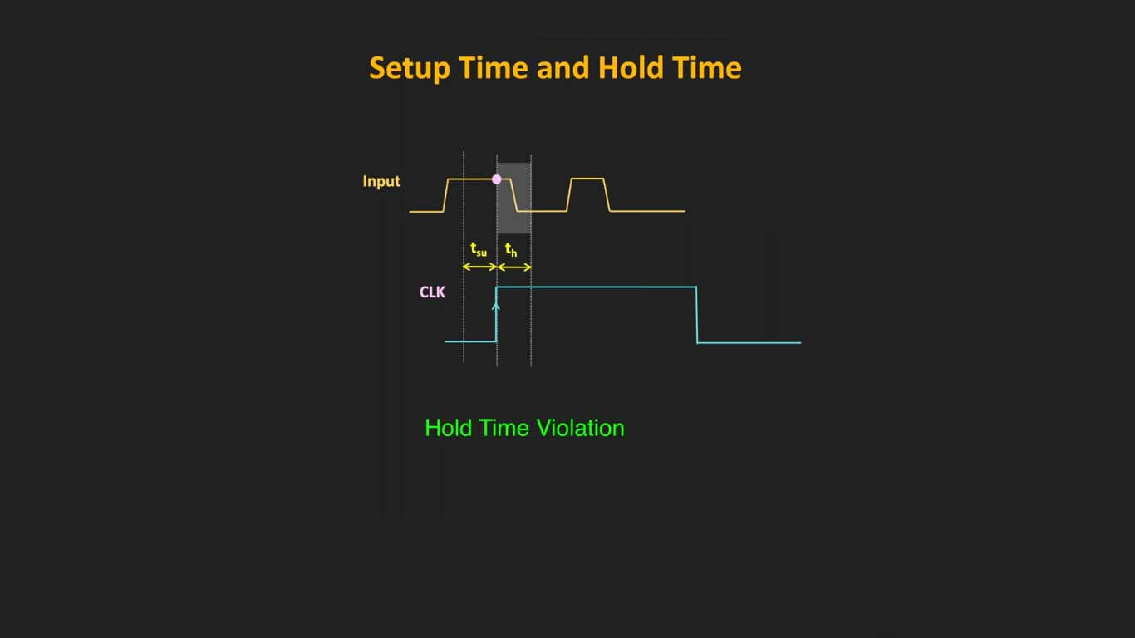
If your design has setup or hold time violations, the Flip-Flop output is not guaranteed to be stable. It could be zero, it could be one, it could be somewhere in the middle, it’s not known. This is called metastability

Slide 12
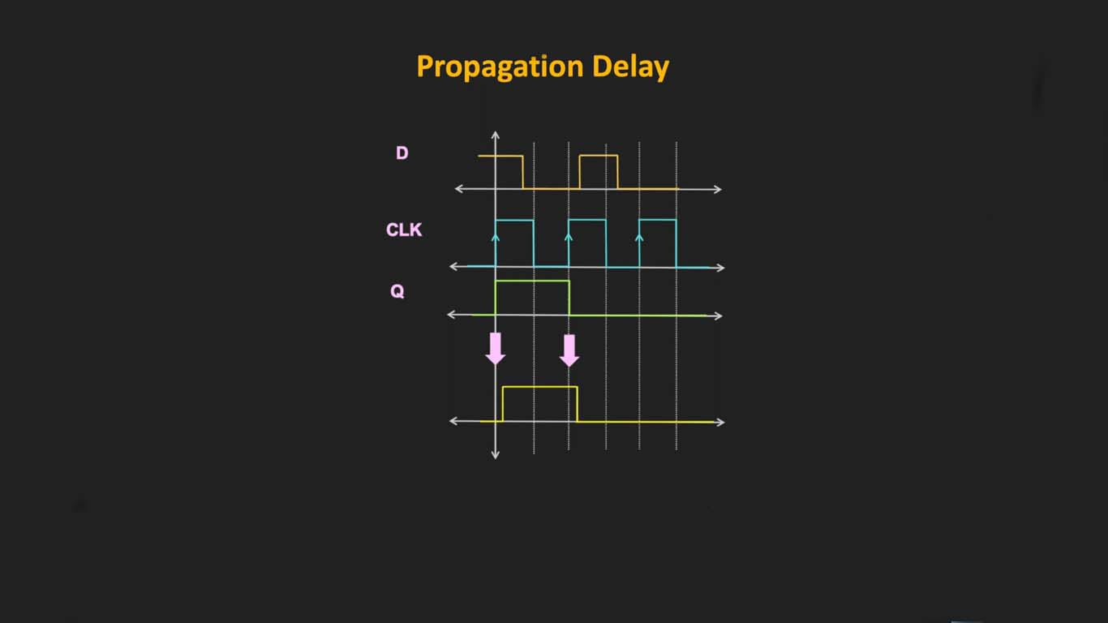
Propagation delay is the amount of time required for a signal to be received after it has been sent; it is caused by the time it takes for the signal to travel through a medium. Propagation delay is of primary interest in electronic circuit design and computer networking, although all signals will inherently experience some form of propagation delay.

